Slide 1
Selective Visual Representations Improve Convergence and Generalization for Embodied-AI
embodied-codebook.github.io
Ainaz Eftekhar*, Kuo-Hao Zeng*, Jiafei Duan, Ali Farhadi
Ani Kembhavi, Ranjay Krishna
ICLR 2024 [Spotlight]
Notes:
We present “Selective Visual Representations Improve Convergence and Generalization for Embodied-AI”

Slide 2
Human perception is a selective mechanism
Notes:
Human vision doesn't process every single detail in the scene. We selectively filter out details and focus on the most relevant parts, depending on the task at hand. Human vision is not a passive response to all available visual stimuli.
We selectively filter out details and focus on the most relevant parts, depending on the task at hand

Slide 3
Human perception is a selective mechanism
Find the remote control
Notes:
When searching for the remote control in our living room, we overlook many visual details in the scene. We focus on flat surfaces, such as coffee tables or TV stands, where the remote is typically placed.

Slide 4
Human perception is a selective mechanism
Find your books
Notes:
Similarly, when looking for a book, our attention is directed solely to the bookshelf, disregarding other visual stimuli."

Slide 5
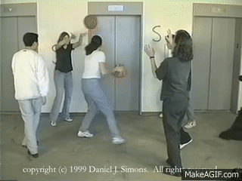
Top-down Selective Attention
ICLR 2024
Human perception is filtered based on the internal goals.
Desimone, R., & Duncan, J. (1995). Neural mechanisms of selective visual attention. Annual review of neuroscience, 18(1), 193-222.
Simons, D. J., & Chabris, C. F. (1999). Gorillas in our midst: Sustained inattentional blindness for dynamic events. perception, 28(9), 1059-1074.
Notes:
In cognitive psychology, selective attention is a mechanism where perception is filtered based on the internal goals. People can get blind to visible objects, that are irrelevant to the their task. In the famous gorilla experiment, individuals are asked to count the ball passes between white-shirt players and fail to notice a black gorilla crossing the scene.”

Slide 6
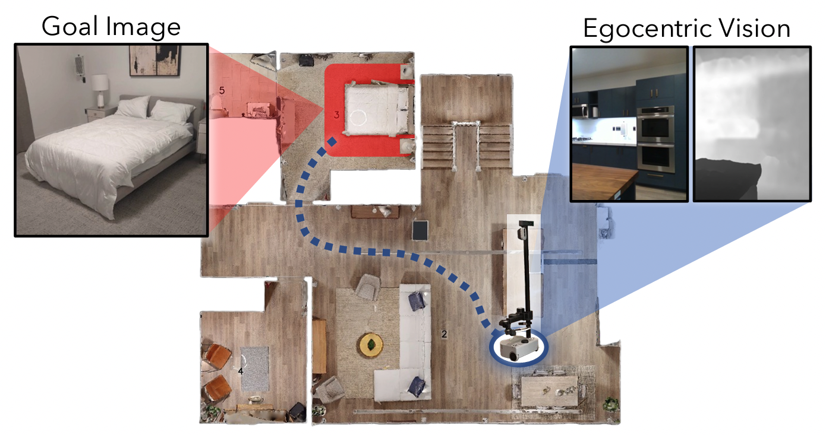
Embodied-AI agents have goal-driven behaviors
ICLR 2024
Image-Goal Navigation
Mobile Manipulation
ManipulaTHOR, Ehsani et al., CVPR 2021
Navigating to Objects Specified by Images, Krantz et al., CVPR 2023
Notes:
Embodied-AI agents have similar goal-directed behaviors, such as navigating to a specific goal or relocating target objects.

Slide 7
Embodied-AI agents use general-purpose visual backbones
ICLR 2024
Input Frame
Visual
Encoder
Policy
Act
EmbCLIP, Khandelwal et al., CVPR 2022
SPOC, Ehsani et al., CVPR 2024
Notes:
However they employ off-the-shelf visual backbones.
These encoders are pretrained on general-purpose vision tasks and stay frozen throughout the embodied training.

Slide 8
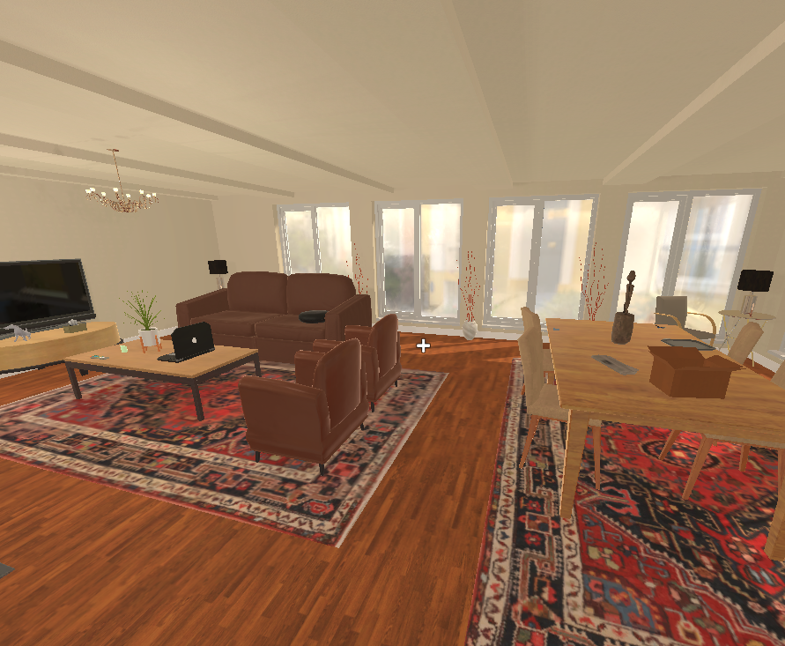
Standard visual encoders capture general-purpose scene information
ICLR 2024
Task: Find the key
Notes:
Consider an agent tasked with locating a key in an environment.”

Slide 9
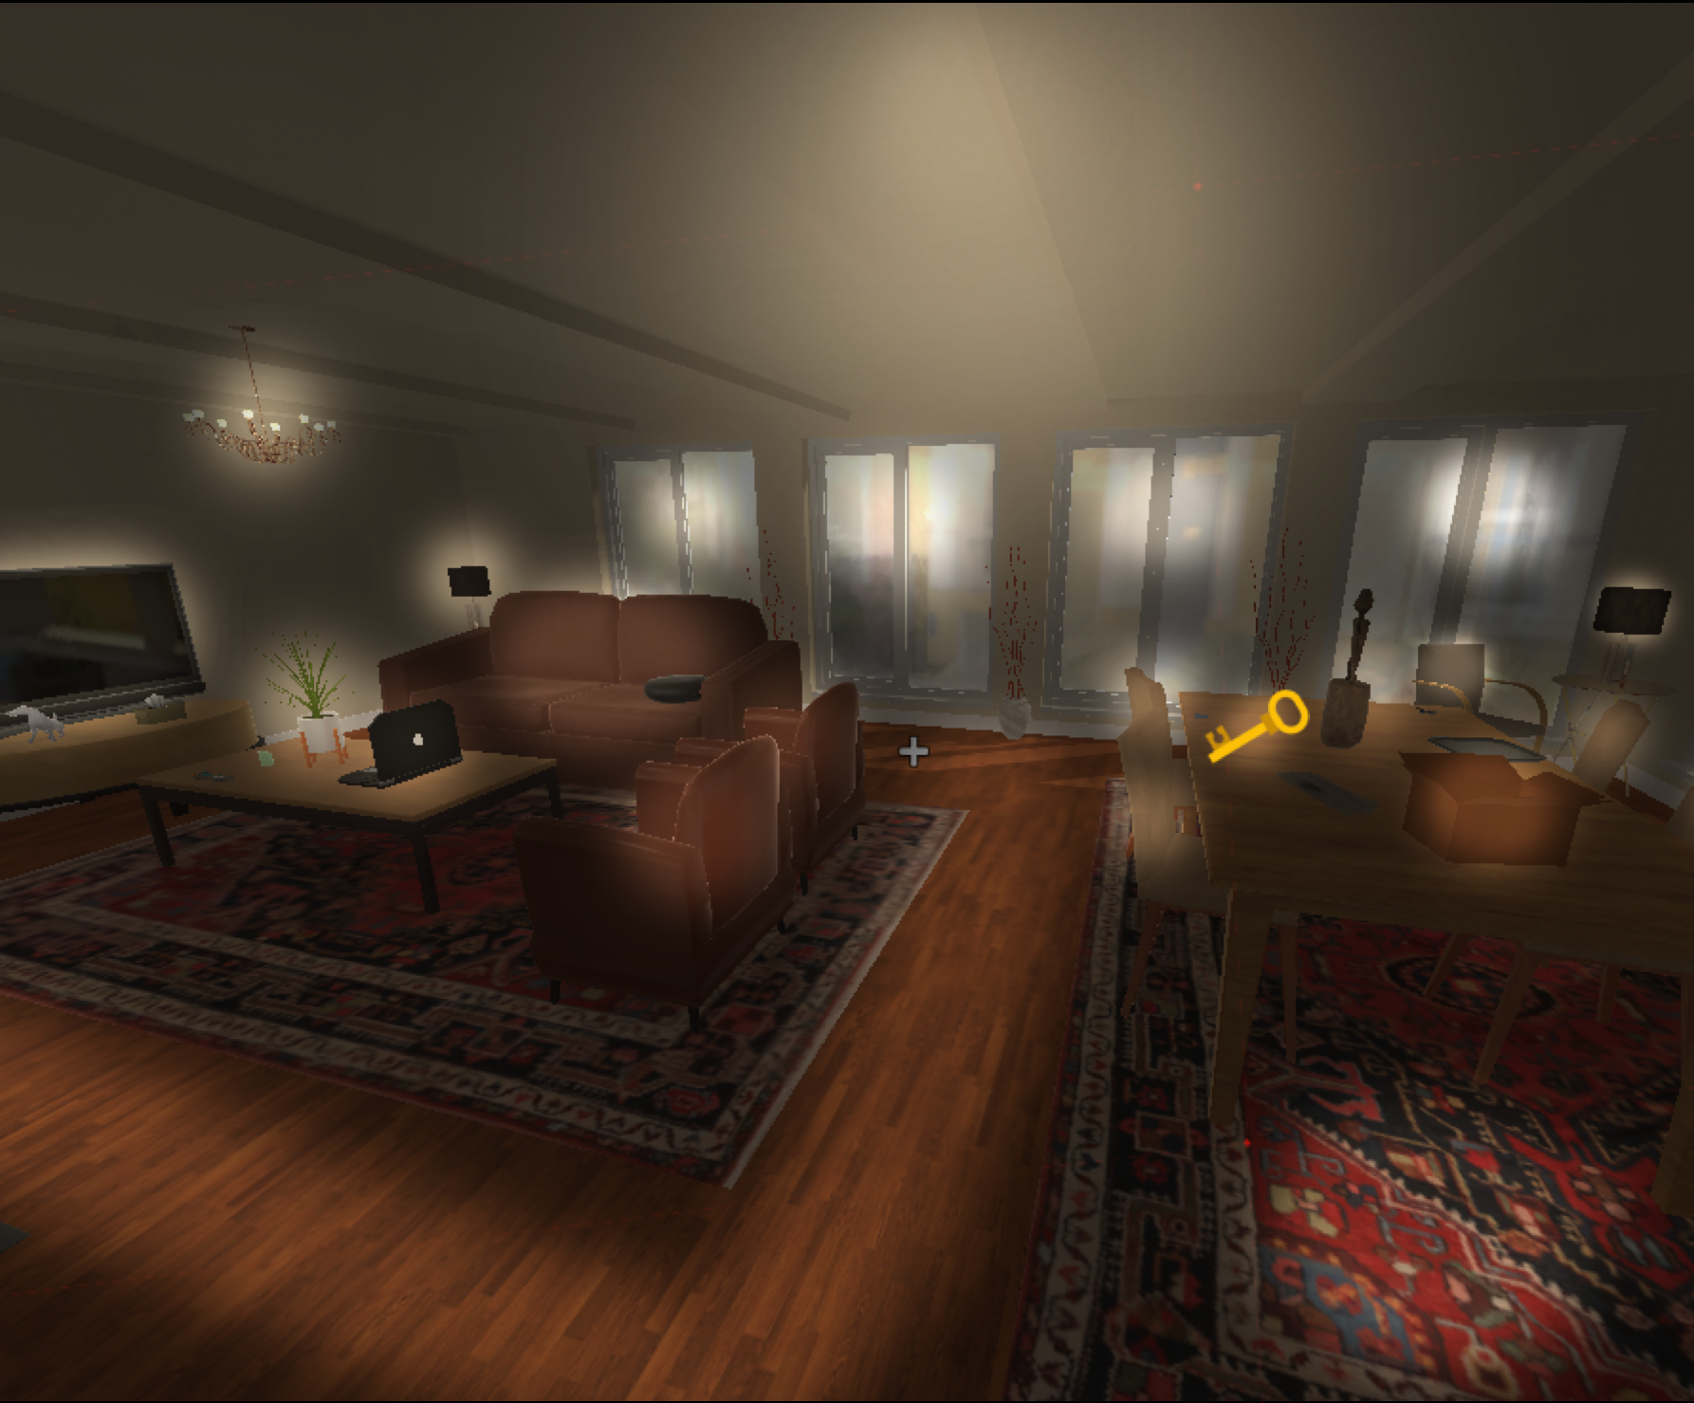
Standard visual encoders capture general-purpose scene information
ICLR 2024
Bottom-Up Processing
Input Frame
Gray ceiling
Chandelier
4 big windows
TV
Black lamp
Green plant in a white vase
General-purpose Encoder
Key
3 brown sofas
Coffee table with a laptop on the surface
Brown box
Wooden
floor
Goal: Key
Textured carpet
Walkable path
Notes:
Pretrained vision encoders like CLIP or DINO capture an abundance of task-irrelevant details such as distracting objects, their colors and attributes. These details introduce noise in the learning process and distract the agent from more important visual cues.

Slide 10
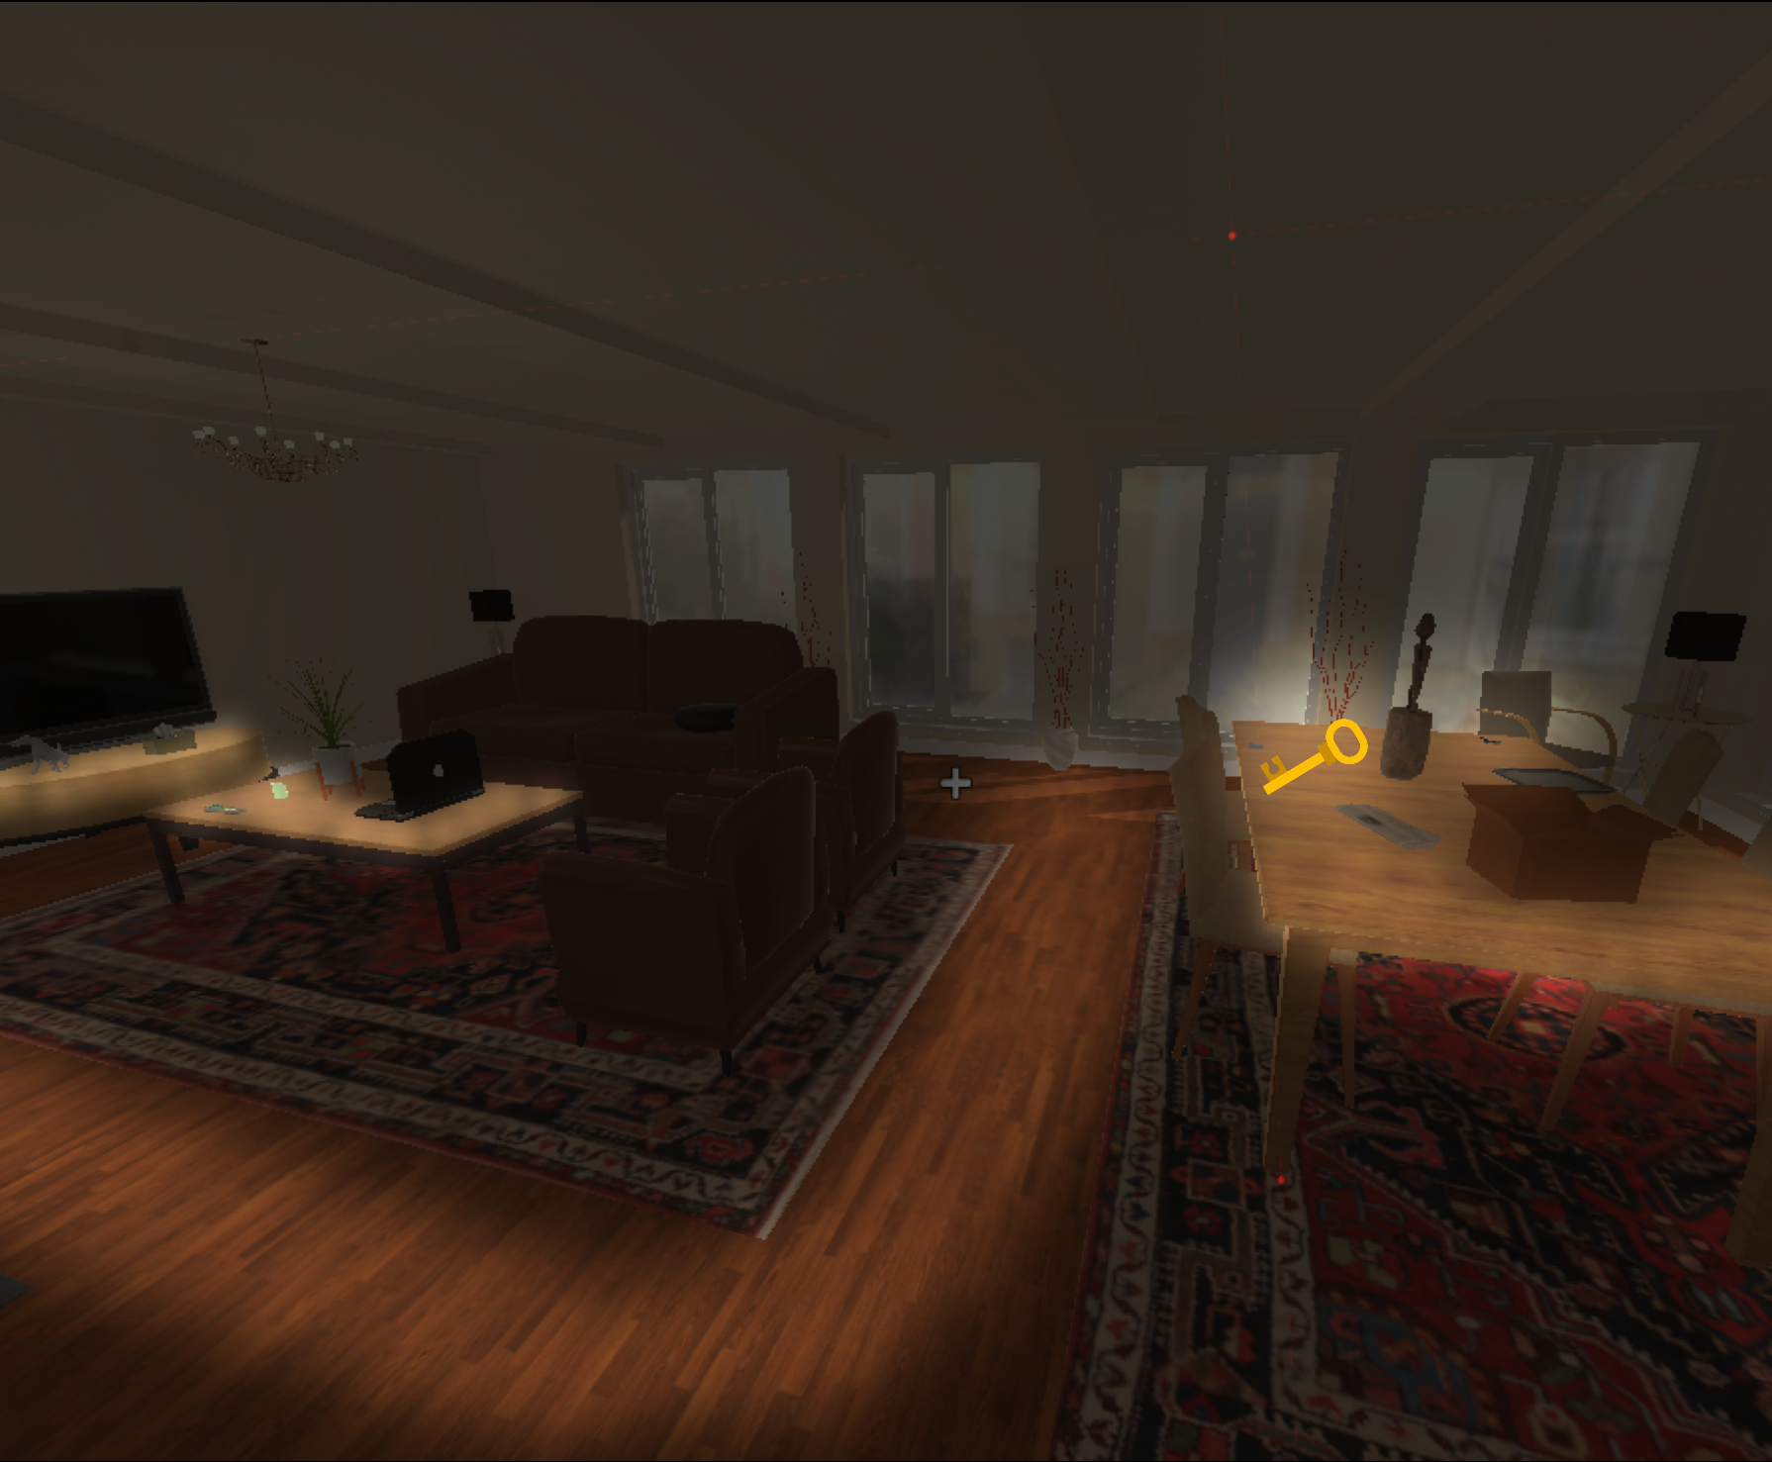
Goal-Driven Visual Encoder retains the most task-relevant information
ICLR 2024
Top-Down Selective Attention
Input Frame
TV
Flat surface might contain the key
Goal-Driven
Encoder
Key
Flat surface might contain the key
Goal: Key
Walkable path to the flat surfaces
Notes:
A goal-driven visual encoder based on selective attention will only retain the most relevant information to the task, such as identifying flat surfaces likely to hold the key.

Slide 11
Standard Embodied-AI architectures
ICLR 2024
Input Frame
Visual
Encoder
$$E$$
Recurrent
State Encoder
Action
CNN
Actor-Critic
Goal: Chair
Embedder
$$g∈\{0,...,11\}$$
$$1574×1$$
Previous
Action
Embedder
Notes:
Standard embodied-AI architectures contain 3 encoders to embed the visual observation, goal, and previous action

Slide 12
Standard Embodied-AI architectures
ICLR 2024
Input Frame
Visual
Encoder
$$E$$
Recurrent
State Encoder
Action
CNN
Actor-Critic
Goal: Chair
Embedder
$$g∈\{0,...,11\}$$
$$1574×1$$
Previous
Action
Embedder
Notes:
The 3 embeddings are fused to form a goal-conditioned visual representation often with dimensions a large as 1500.

Slide 13
Standard Embodied-AI architectures
ICLR 2024
Remember what it has seen in the past
Decide an action based on the information
Input Frame
Visual
Encoder
$$E$$
Recurrent
State Encoder
Action
CNN
Actor-Critic
Goal: Chair
Embedder
$$g∈\{0,...,11\}$$
$$1574×1$$
Previous
Action
Embedder
Notes:
A recurrent neural network followed by a small actor-critic decide an action based on the observations seen in the past
A recurrent neural network followed by a small actor-critic must remember what it has seen in the past and act accordingly.
A recurrent neural network followed by a small actor-critic module must identify the essential task-related information and act accordingly.”

Slide 14
Goal-Bottlenecked Architecture
Codebook Module
Input Frame
Visual
Encoder
$$E$$
$$\overset{̂}{E}$$
Scoring Function $ϕ$
Convex Combination
Upsampling
Layer
CNN
Linear
Softmax
Linear
Recurrent
State Encoder
Action
Actor-Critic
Goal: Chair
Embedder
$$256×1$$
Codebook
$$10×1$$
$$g∈\{0,...,11\}$$
$$1574×1$$
$$1$$
$$1574×1$$
$$2$$
.
.
.
$$3$$
Filtered visual observation
Previous
Action
Embedder
$$K$$
$$C∈R^{256×10}$$
Notes:
We propose a compact codebook module as a goal-conditioned bottleneck to capture task-related information. This allows the policy to focus solely on decision-making based on the filtered observation.
The codebook contains a small set of low-dimensional latent codes, jointly optimized for task reward. The compressed visual embedding is a convex combination of these low-dimensional latent codes.”

Slide 15
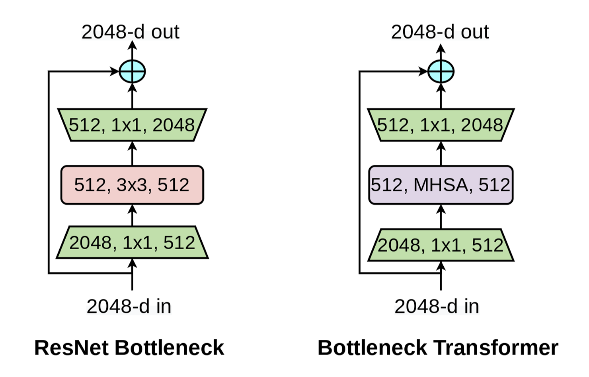
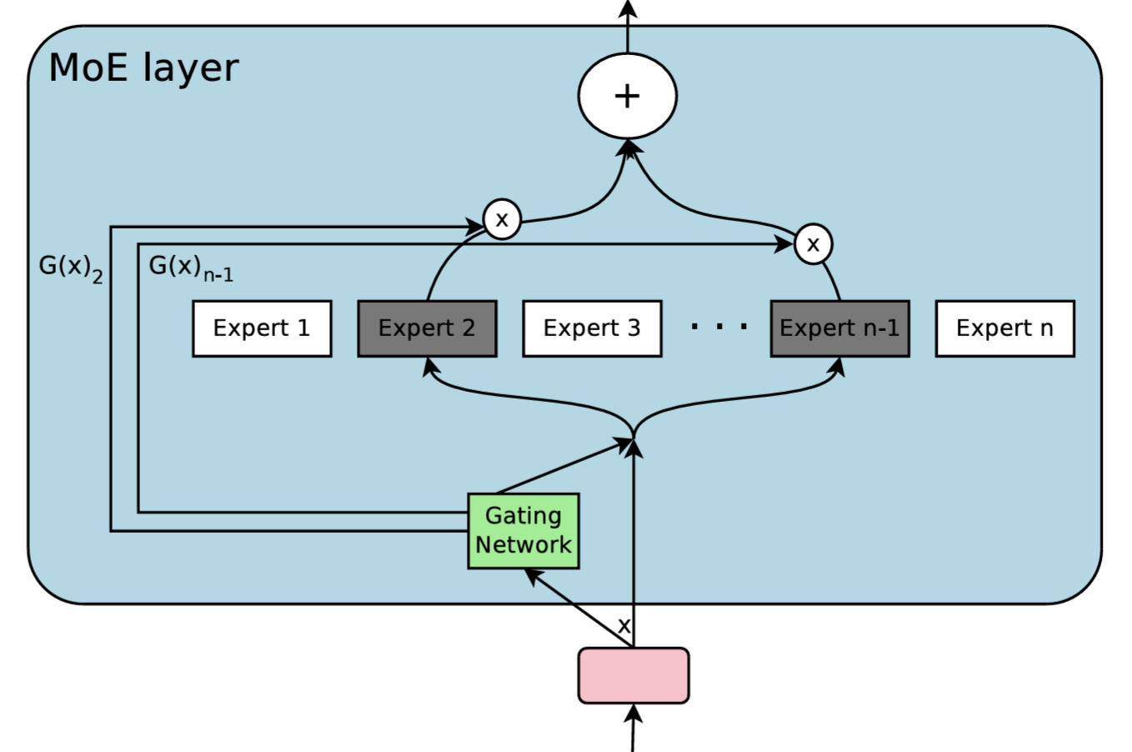
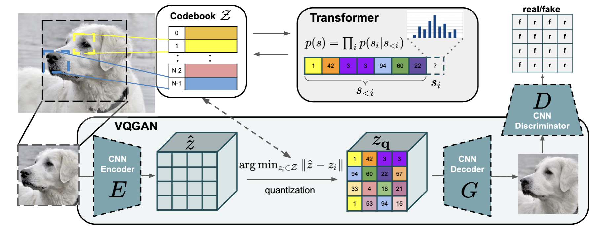
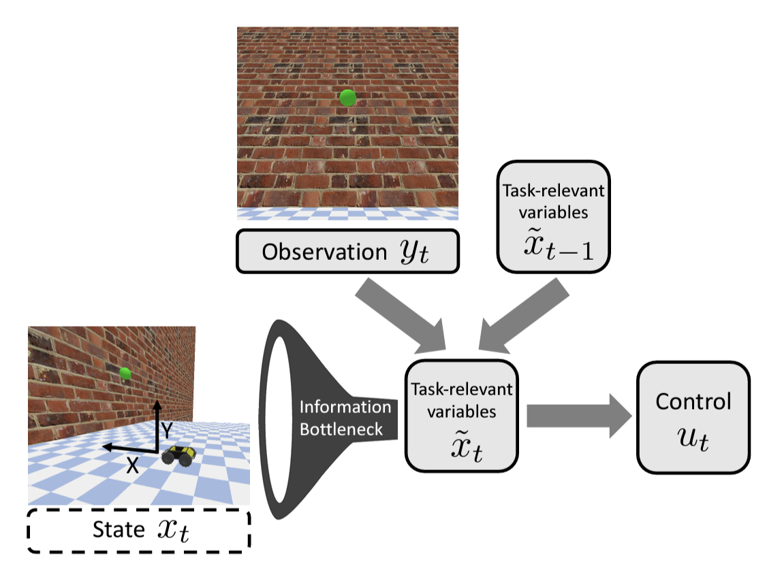
Bottleneck-based Architectures
ICLR 2024
Mixture-of-Experts
Shazeer et al.
ICLR 2017
Bottleneck Transformer
Srinivas et al.
CVPR 2021
DRIBO
Fan et al.
PMLR 2022
VQGAN
Esser et al.
CVPR 2021
Task-Driven
Control Policies
Pacelli et al.
RSS 2020
VIBERT
Mahabadi et al.
ICLR 2021
Notes:
Similar to our codebook bottleneck, previous bottlenecked architectures have been applied in computer vision, natural language processing, as well as reinforcement learning and robotics.

Slide 16
Benefits of codebook-bottlenecked representations in Embodied-AI
ICLR 2024
Improve performance and convergence in Embodied-AI
Improved agent behavior: smoother trajectories and more efficient exploration
More generalizable to new visual domains
Captures the most task-relevant information
Representation-agnostic and applicable to various visual encoders
Notes:
Next we go through the various benefits of codebook-bottlenecked representations

Slide 17
Benefits of codebook-bottlenecked representations in Embodied-AI
ICLR 2024
Improve performance and convergence in Embodied-AI
Improved agent behavior: smoother trajectories and more efficient exploration
More generalizable to new visual domains
Captures the most task-relevant information
Representation-agnostic and applicable to various visual encoders

Slide 18
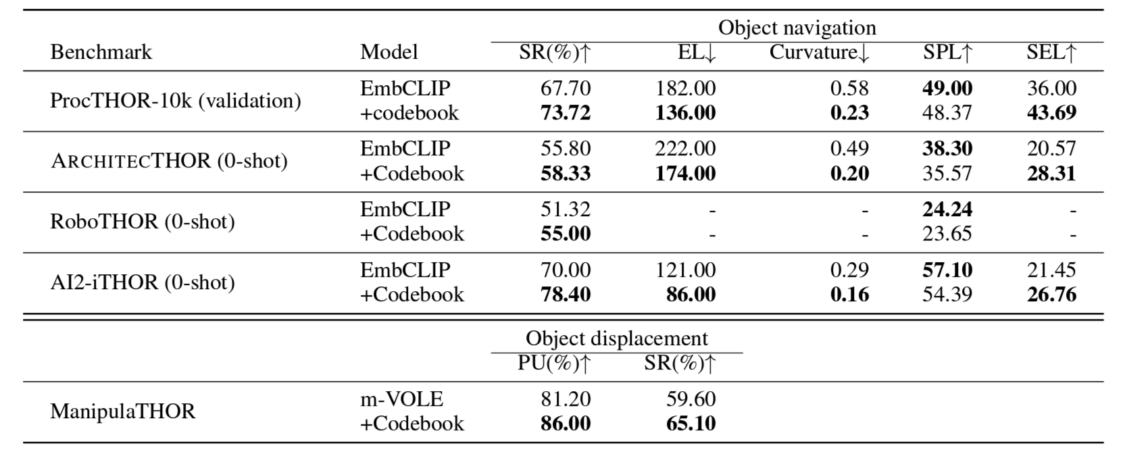
Codebook-Bottlenecked Representations Improve Performance in Embodied-AI
ICLR 2024
EmbCLIP, Khandelwal et al., CVPR 2022
Notes:
We outperform SOTA across 5 embodied-AI benchmarks. Our agent achieves higher success rate and lower episode length.

Slide 19
Codebook-Bottlenecked Representations Improve Performance in Embodied-AI
ICLR 2024
Notes:
travels in smoother trajectories.

Slide 20
Codebook-Bottlenecked Representations Improve Performance in Embodied-AI
ICLR 2024
Notes:
And is more efficient in solving the tasks.

Slide 21
Benefits of codebook-bottlenecked representations in Embodied-AI
ICLR 2024
Improve performance and convergence in Embodied-AI
Improved agent behavior: smoother trajectories and more efficient exploration
More generalizable to new visual domains
Captures the most task-relevant information
Representation-agnostic and applicable to various visual encoders

Slide 22
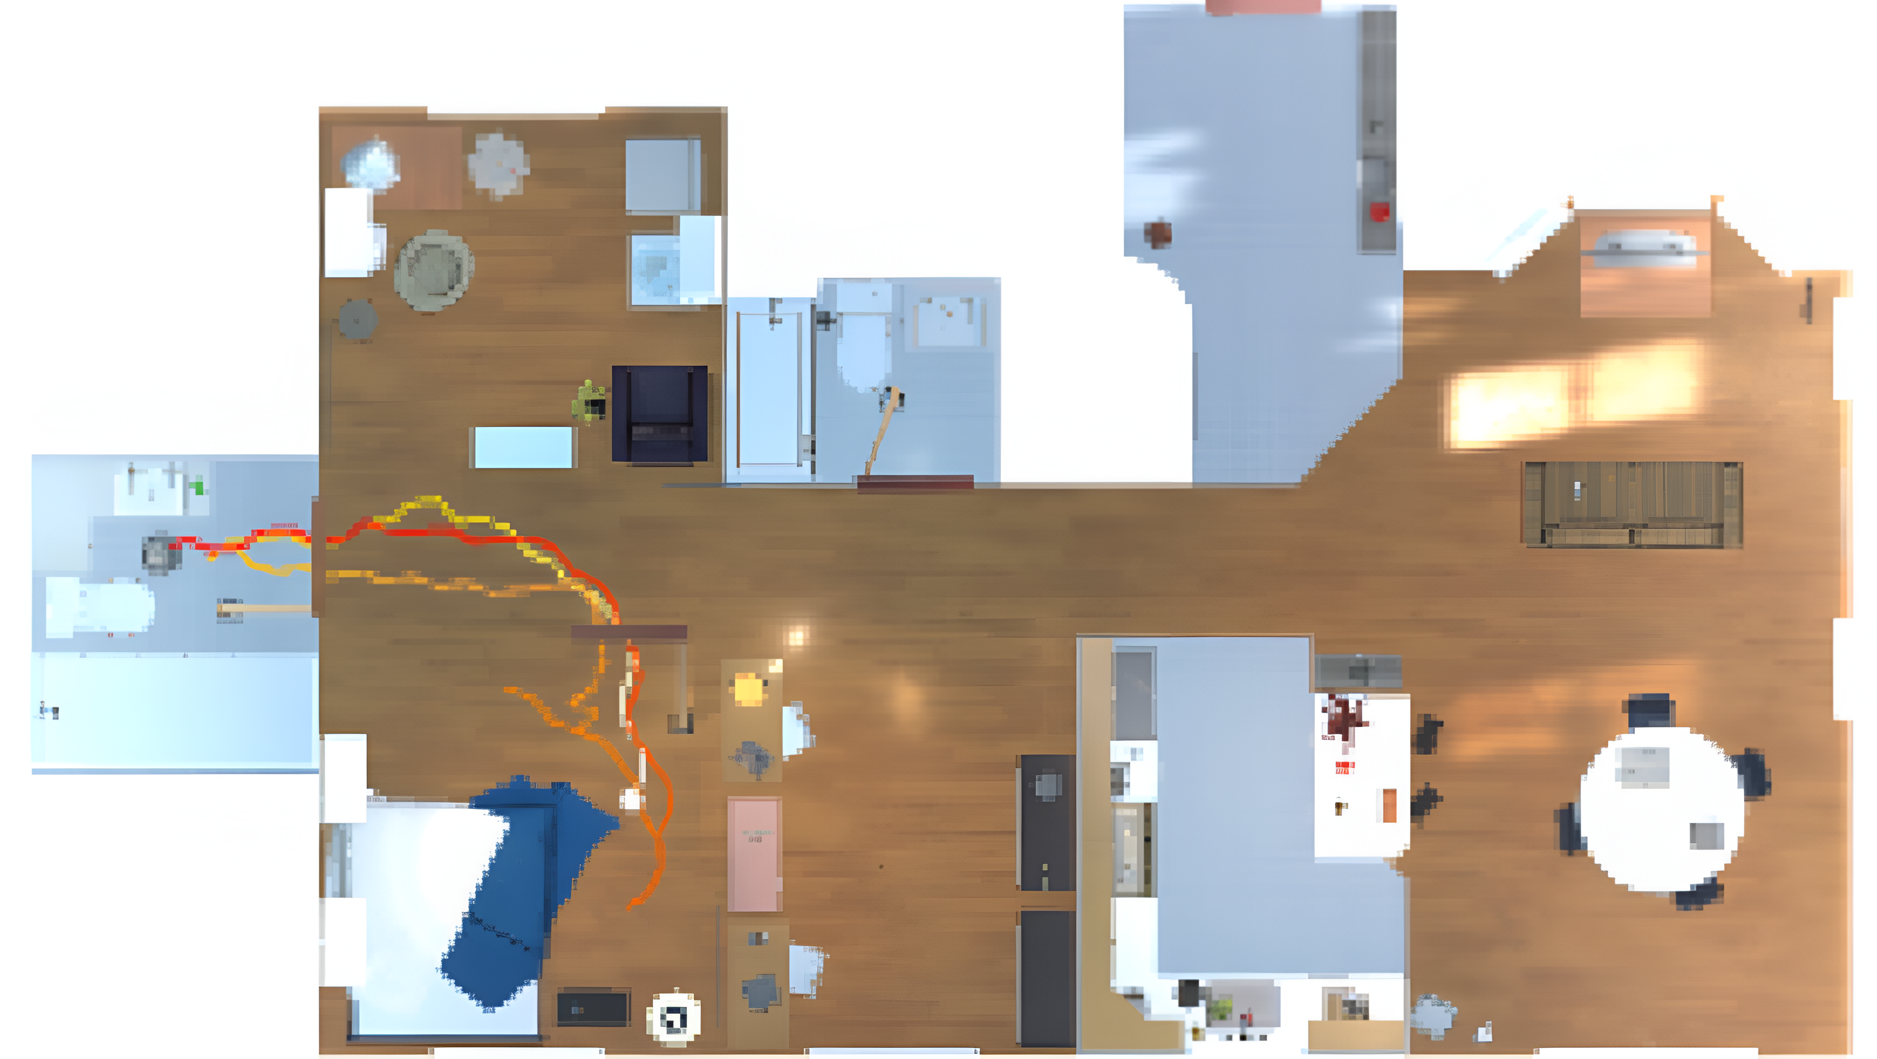
Our agent explores more efficiently and in smoother trajectories
ICLR 2024
Success
Fail
End
Start
Start
End
Goal
Goal
EmbCLIP
EmbCLIP + Codebook
Notes:
We observe noticeable improvements in agent behavior. Namely exploring more efficiently and traveling in smoother paths.

Slide 23
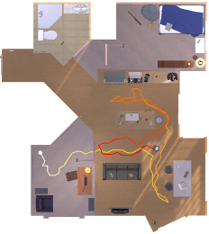
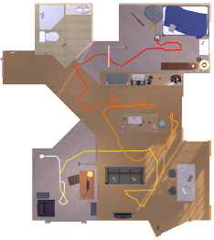
Our agent explores more efficiently and in smoother trajectories
ICLR 2024
Success
Goal
Goal
Fail
End
Start
End
Start
EmbCLIP
EmbCLIP + Codebook
Notes:
While the baseline agent takes redundant rotations and performs poorly in exploration

Slide 24
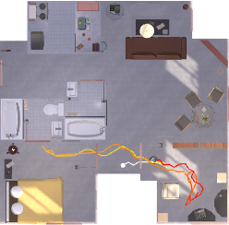
Our agent explores more efficiently and in smoother trajectories
ICLR 2024
Success
Fail
Goal
End
Start
EmbCLIP
Notes:
"Comparing the first-person views of the two agents reveals that the baseline agent frequently makes redundant rotations

Slide 25
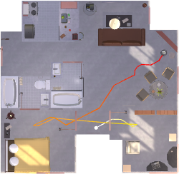
Our agent explores more efficiently and in smoother trajectories
ICLR 2024
Success
Fail
Goal
End
Start
EmbCLIP + Codebook
Notes:
whereas our agent follows much smoother paths.”

Slide 26
Benefits of codebook-bottlenecked representations in Embodied-AI
ICLR 2024
Improve performance and convergence in Embodied-AI
Improved agent behavior: smoother trajectories and more efficient exploration
More generalizable to new visual domains
Captures the most task-relevant information
Representation-agnostic and applicable to various visual encoders

Slide 27
Codebook embeddings generalize to new visual domains
ICLR 2024
CLIP
ResNet
CNN
Input Frame
$$r$$
Recurrent
State Encoder
Scoring
Function $ϕ$
Upsampling
Layer
Actor-Critic
CNN
Embedder
Goal: Chair
Codebook
$$g∈\{0,...,11\}$$
Previous
Action
Decision-Making Modules
Embedder
Notes:
To investigate the transfer to new visual domains such as a new simulator, we keep the decision-making modules frozen

Slide 28
Codebook embeddings generalize to new visual domains
ICLR 2024
Adaptation Module
CLIP
ResNet
CNN
Input Frame
$$r$$
Recurrent
State Encoder
Scoring
Function $ϕ$
Upsampling
Layer
Actor-Critic
CNN
Embedder
Goal: Chair
Codebook
$$g∈\{0,...,11\}$$
Previous
Action
Decision-Making Modules
Embedder
Notes:
and only fine-tune the parameters responsible for extracting the visual cues.

Slide 29
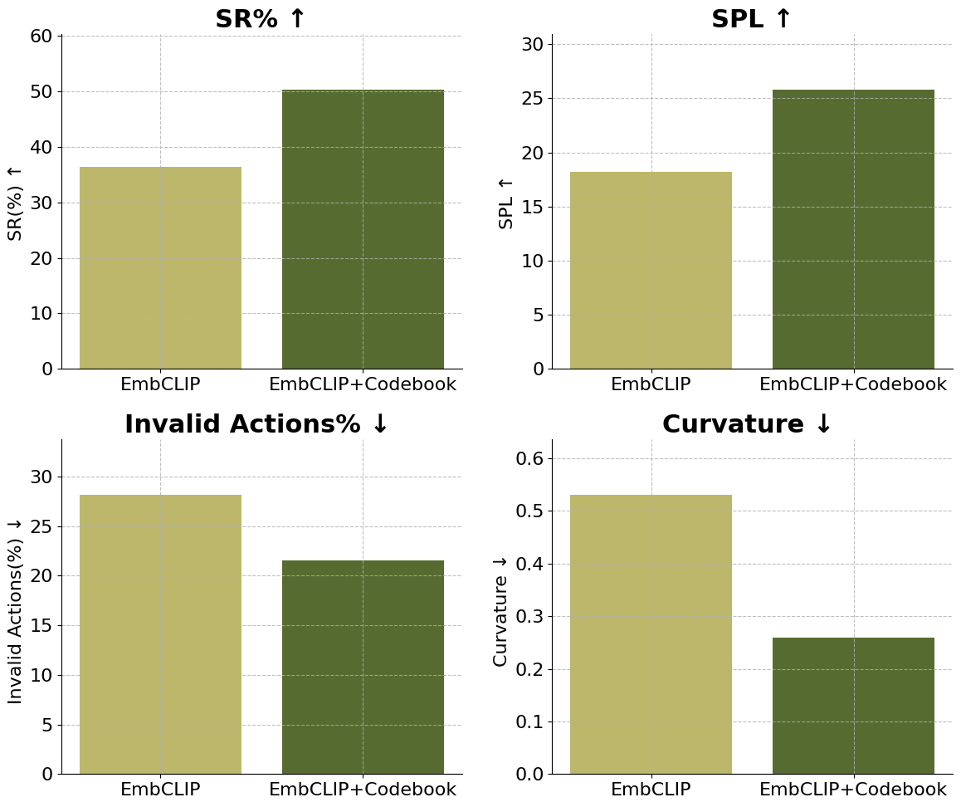
Better generalization to new visual domains
13.80
7.58
6.60
0.27

Slide 30
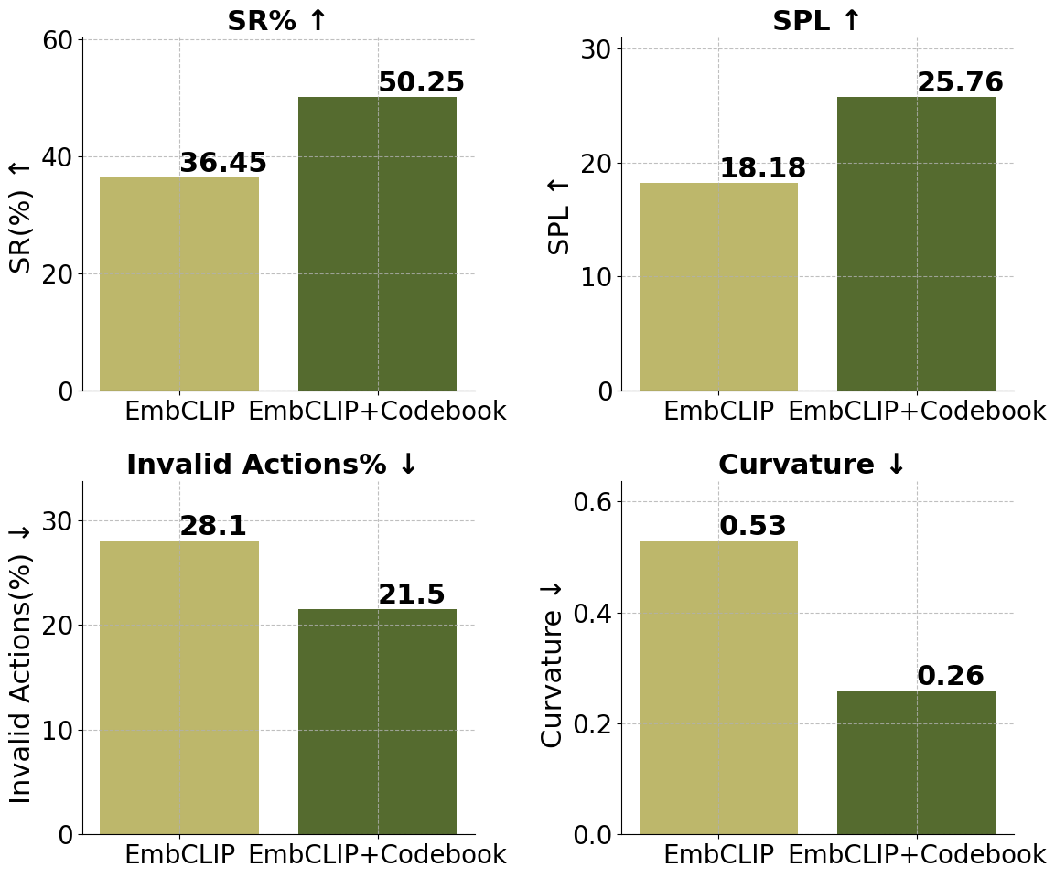
Codebook embeddings generalize to new visual domains
ICLR 2024
Pre-train:
Finetune:
Notes:
Our architecture shows better transfer when faced with similar tasks in new visual domains. As shown by the huge improvement across all metrics in the new simulator.

Slide 31
Benefits of codebook-bottlenecked representations in Embodied-AI
ICLR 2024
Improve performance and convergence in Embodied-AI
Improved agent behavior: smoother trajectories and more efficient exploration
More generalizable to new visual domains
Captures the most task-relevant information
Representation-agnostic and applicable to various visual encoders

Slide 32
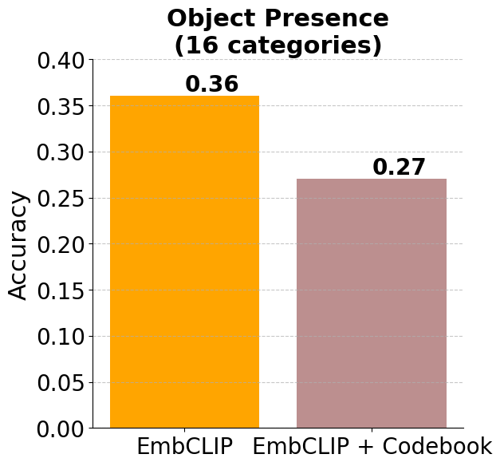
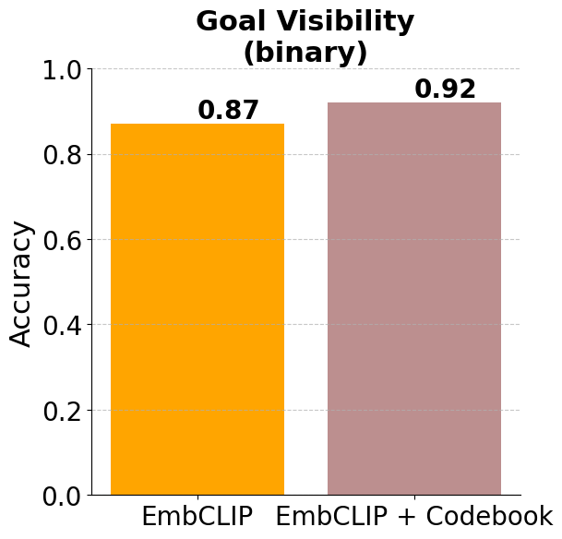
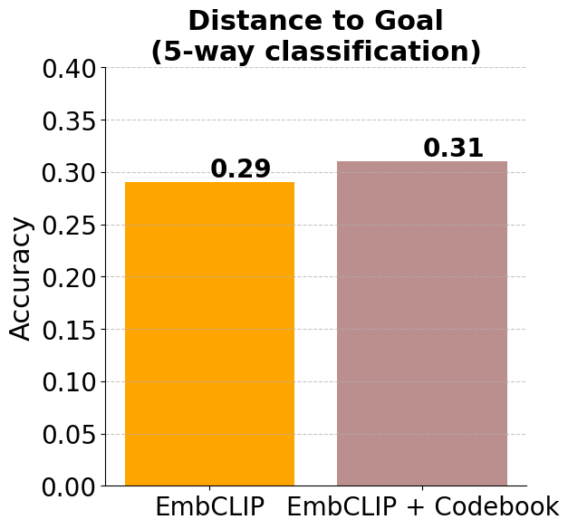
Codebook-bottlenecked embeddings retain the most task-relevant information
ICLR 2024
Task-Irrelevant
Task-Relevant
Notes:
We employ linear probing for a set of primitive tasks to evaluate the information captured in our embeddings While the new representation is suboptimal in object detection from non-goal categories, it’s more effective in predicting task-related information such as goal visibility and proximity.

Slide 33
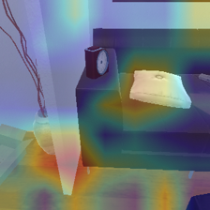
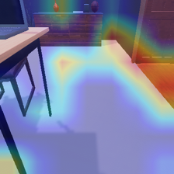
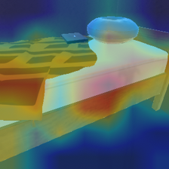
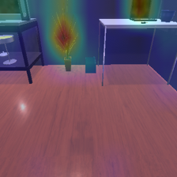
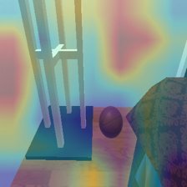
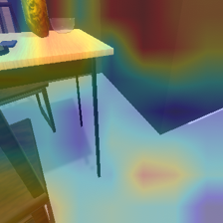
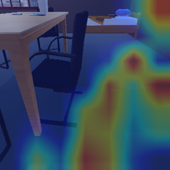
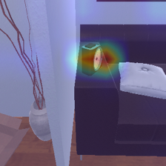
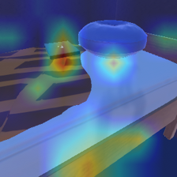
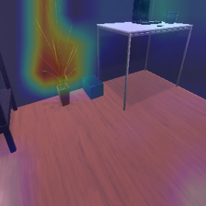
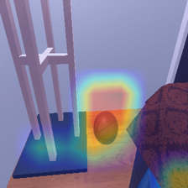
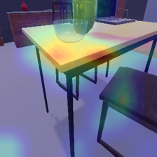
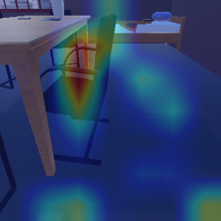
Codebook-bottlenecked embeddings retain the most task-relevant information
ICLR 2024
Alarm Clock
Vase
Laptop
House Plant
Basketball
Bowl
Chair
EmbCLIP
EmbCLIP-Codebook
Notes:
GradCAM attention maps further show our model effectively ignores distractions, and only focus on object goals.

Slide 34
Codebook-bottlenecked embeddings retain the most task-relevant information
ICLR 2024
Query Image
Nearest Neighbors
Goal:
BasketBall
HousePlant
Television
Bed
Goal: Vase
EmbCLIP
+Codebook
Goal:
Bowl
Mug
Vase
Vase
EmbCLIP
Notes:
According to the nearest neighbors, our visual embeddings group frames by goal visibility and proximity, while the baseline focuses on scene semantics.
In this example, our nearest neighbors display frames where the object goal is clearly visible, similar to the query image. While the baseline neighbors consistently display a wooden table.”

Slide 35
Codebook-bottlenecked embeddings retain the most task-relevant information
ICLR 2024
Query Image
Nearest Neighbors
Goal:
GarbageCan
BaseBallBat
GarbageCan
Bed
Goal: Toilet
EmbCLIP
+Codebook
Goal:
Toilet
Toilet
Toilet
Toilet
EmbCLIP
Notes:
Here the goal is seen at a further distance in all our nearest neighbors.

Slide 36
Codebook-bottlenecked embeddings retain the most task-relevant information
ICLR 2024
Query Image
Nearest Neighbors
Goal:
Apple
Apple
AlarmClock
Vase
Goal: Bowl
EmbCLIP
+Codebook
Goal:
Apple
Apple
Apple
Apple
Query Image and Goal
EmbCLIP
Notes:
When the goal isn’t visible in the query frame, our nearest neighbors are based on overall scene layout, whereas the baseline neighbors are selected based on appearance and texture."

Slide 37
Benefits of codebook-bottlenecked representations in Embodied-AI
ICLR 2024
Improve performance and convergence in Embodied-AI
Improved agent behavior: smoother trajectories and more efficient exploration
More generalizable to new visual domains
Captures the most task-relevant information
Representation-agnostic and applicable to various visual encoders

Slide 38
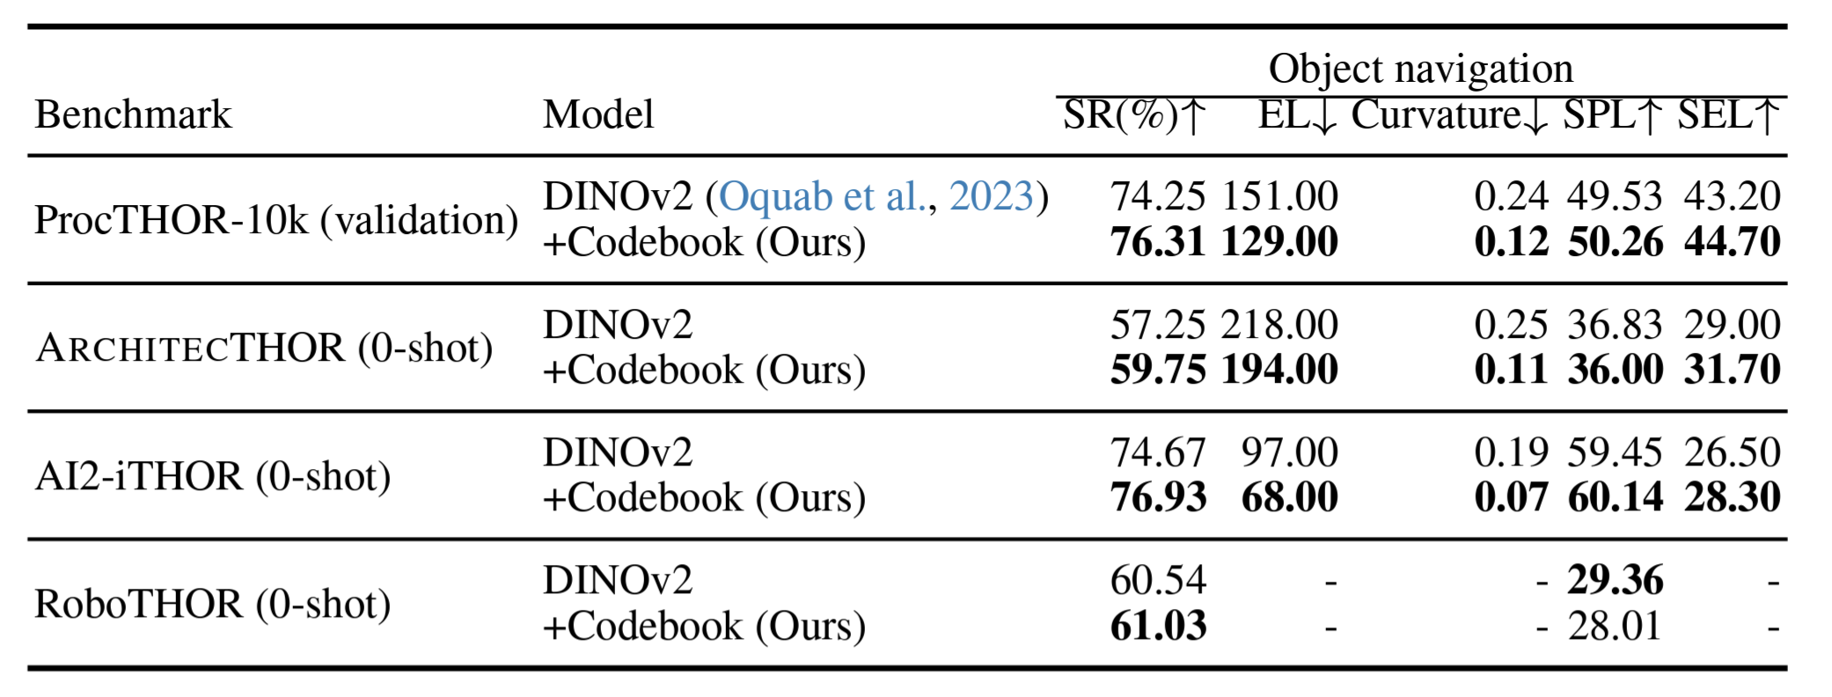
Codebook module is representation-agnostic
ICLR 2024
DINOv2, Squab et al., TMLR 2024
Notes:
By replacing the CLIP encoder with DINOv2 pretrained encoder, we confirm that the codebook is not dependent on any specific visual representation and can adapt to different visual backbones."

Slide 39
Selective Visual Representations Improve Convergence and Generalization for Embodied-AI
ICLR 2024
Code and Pretrained Models
Website
github.com/allenai/procthor-rl
embodied-codebook.github.io
Ainaz Eftekhar*, Kuo-Hao Zeng*, Jiafei Duan, Ali Farhadi
Ani Kembhavi, Ranjay Krishna
ICLR 2024 [Spotlight]
Notes:
For code and pertained models and more qualitative examples please checkout our website

